Slide 1
RESTAURANT BUSINESS DATA ANALYSIS FROM YELP. NAME : YERUVA JEEVAN REDDY QUALIFICATION: B. Tech. honours (COMPUTER SCIENCE AND ENGINEERING.)

Slide 2
Contents:
Introduction
Tools used
About the data
Analysis and Findings
Suggestions to business

Slide 3
introduction
In this project, I conducted a comprehensive analysis of restaurant data sourced from Yelp using SQL.
Yelp is a popular platform where users can review and rate various businesses, including restaurants.
The dataset I worked with contains valuable information about restaurants, such as their names, locations, ratings, and reviews.
By leveraging SQL, I aimed to extract meaningful insights and patterns from this data to gain a deeper understanding of restaurant business dynamics.

Slide 4
Tools used
MySQL
MySQL Connector
Python
Pandas
Seaborn
Matplotlib
Python forums for mapping techniques

Slide 5
About the data
Business Dataset:
Columns: The number of columns depends on the specific attributes captured for each business but may include attributes like business_id, name, address, city, state, postal code, latitude, longitude, stars (rating), review_count, categories, and more.
About the Data: This dataset provides information about various businesses listed on Yelp, such as restaurants, cafes, boutiques, etc. It includes details like business location, ratings, reviews, categories, and other relevant attributes.

Slide 6
User dataset:
Columns:
The columns may include user_id, name, review_count, average_stars, yelping_since, friends, elite, and more.
About the Data:
This dataset contains information about users who are registered on Yelp.
It may include details such as user activity, review counts, average ratings,
join dates, friend connections, and elite status.
Review Dataset:
Columns: The columns may include review_id, user_id, business_id, stars, date, text, useful, funny, cool, and more.
About the Data:
This dataset comprises user-generated reviews for businesses listed on Yelp.
It includes details such as review ratings, review text, the date of the review, and user interactions with the review .

Slide 7
Tip Dataset:
Columns:
The columns may include user_id, business_id, text, date, compliment_count, and more.
About the Data:
This dataset contains tips or recommendations provided by users for businesses on Yelp. It includes details such as the tip text, the date of the tip, and any associated compliments from other users.
Check-in Dataset:
Columns:
The columns may include business_id and time (representing check-in times).
About the Data:
This dataset records check-in events at various businesses listed on Yelp. It includes details such as the business where the check-in occurred and the time of the check-in.

Slide 8
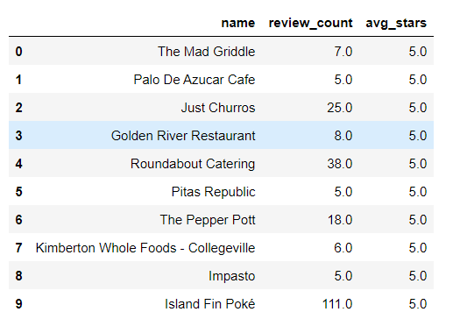
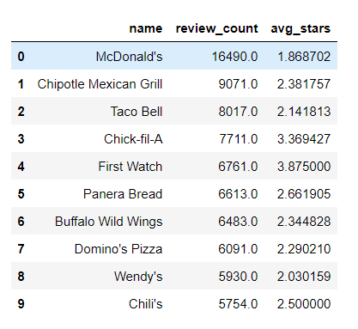
Analysis and Findings
Out of 150k businesses , 35k are restaurants businesses and are open.
Highest Rating : Highest Review_count:
There highest rating do not guarantee the highest review count and highest review count do not guarantee the highest rating.
Business success solely do not determined by review count or rating
Highest review count determines the customer engagement

Slide 9
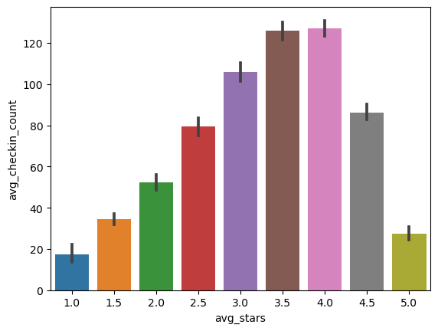
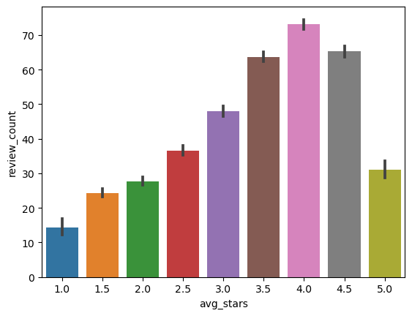
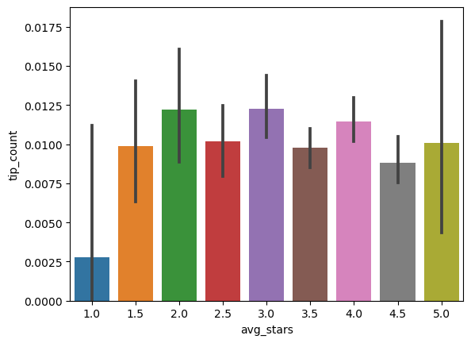
Do restaurants with higher engagement tend to have higher ratings?
Data shows a general increases in the review , check-in and tip count As the rating increases from 1 to 4
Restaurant a having the 4 star rating I having higher customer engagement And down downward trend above 4 star rating
There is a downwards Trent in the customer engagement in 5 star rating

Slide 10
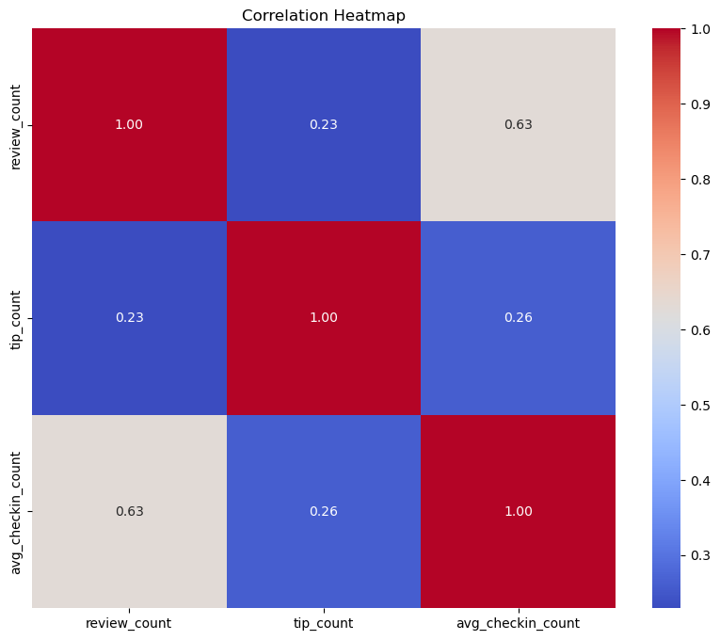
Is there a correlation between the number of reviews,tips and check-ins for a business?
These correlations suggest that user engament across different platforms is interlinked; higher in one area tends to be associated with higher in another area.
Businesses should focus on strategies that boost all types of user engagement as increases in one type of engagement are likely to drive increases in other engagemenrt.

Slide 11
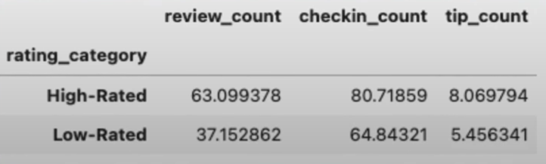
Is there any difference in the user engagement between high-rated and low-rated businesses?
Data shows that there is a clear correlation between higher ratings and icreass user engagement across reviews, tip and check-in counts.
This pattern underscores the importance of maintain high service and qiaulity standards will increases the check-in , tips and reviews.

Slide 12
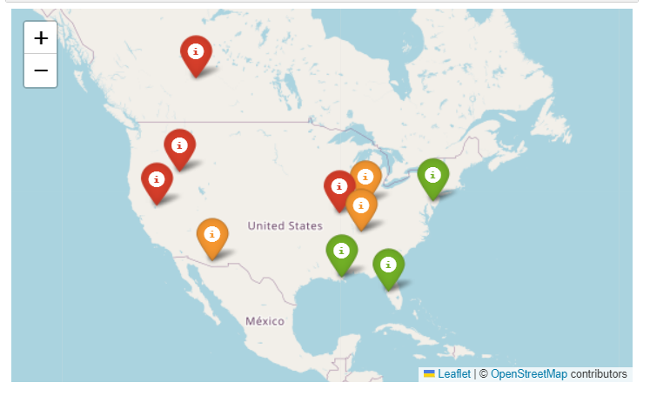
How do the success matrices of the restaurants vary across different state and cities ?
Philadelphia emerges as the top city with the highest success score, indicating a combination of high rating and active user engagement.
Following Philadelphia, Tampa , Indianapolis and Tucson rank among the top cities with significant success score. Suggesting thriving restaurant scenes in these areas

Slide 13
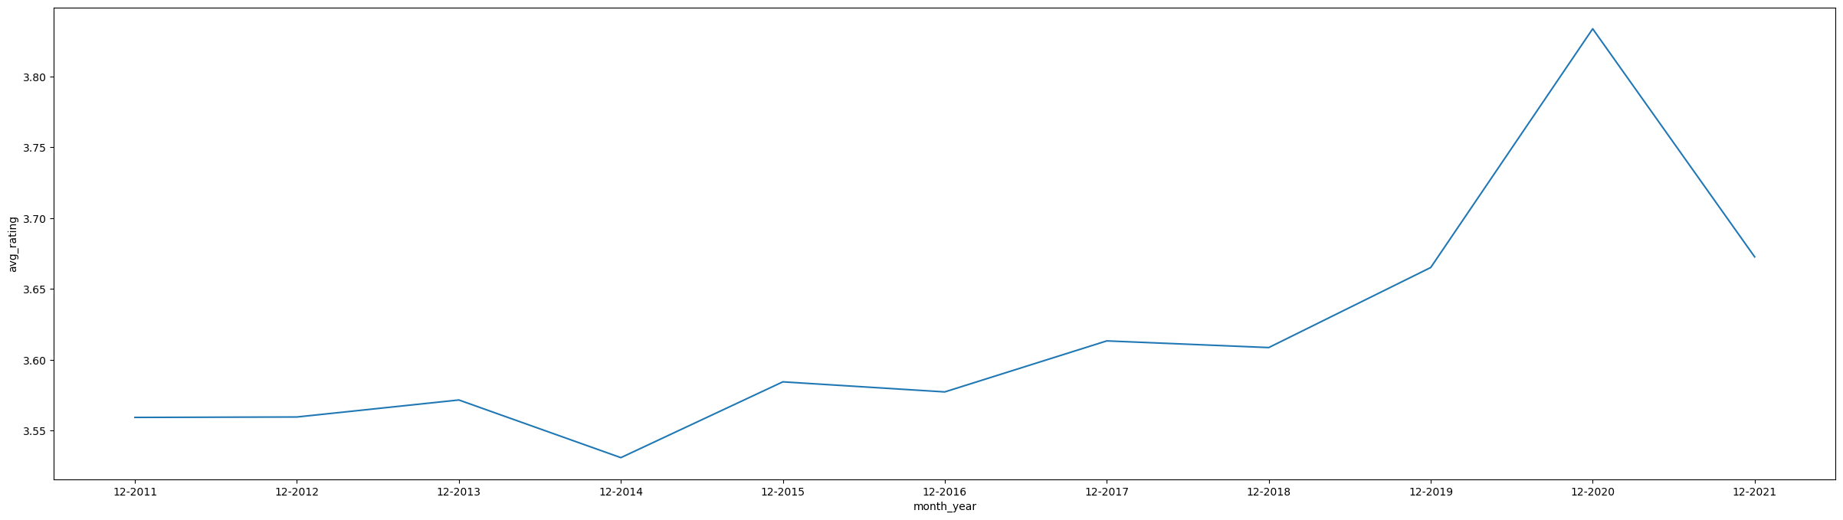
How the rating changed in the last 10 years?
From 2011 to 2020 the over all rating is increasing and we can observe a significant dip in the rating in 2020

Slide 14
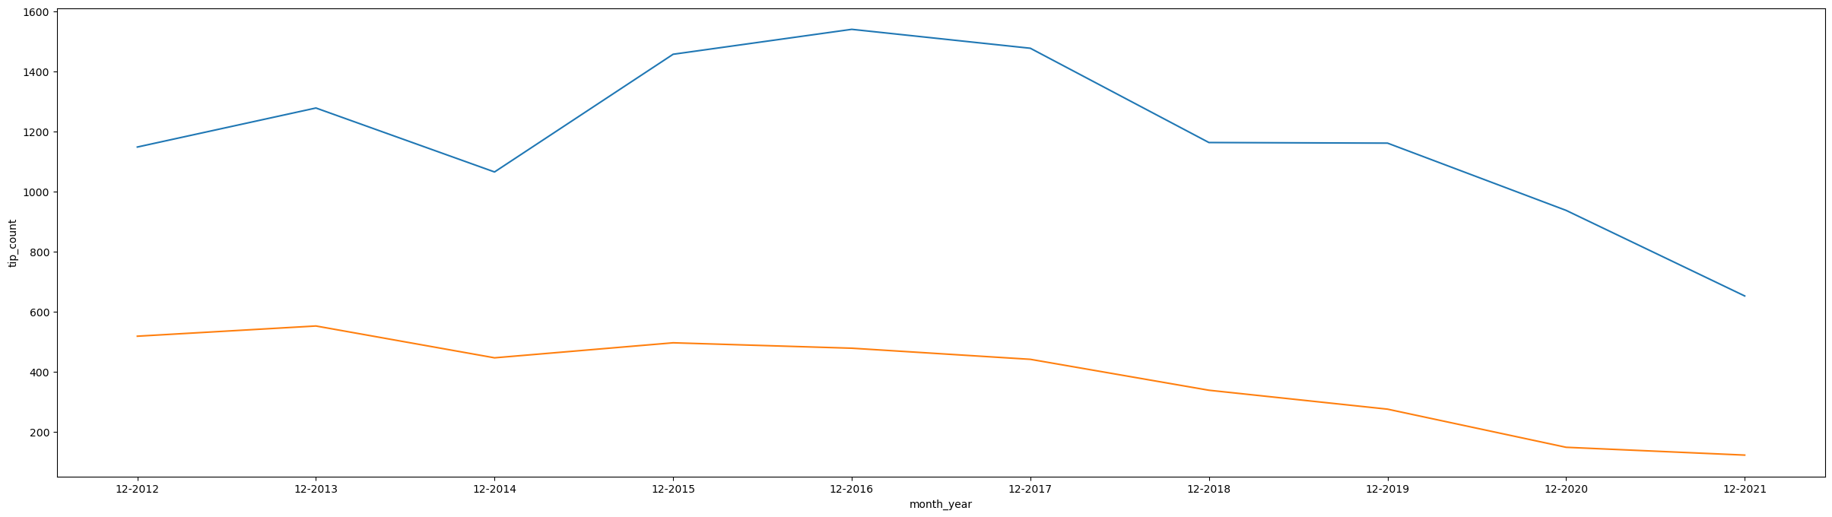
High(>3.5) and low rated(<3.5) vs tip count in last 10 years
From the belove data you can observe the high rated business tip count are fluctuating year by year.
Coming to the low rated businesses the tip count is dropping contently

Slide 15
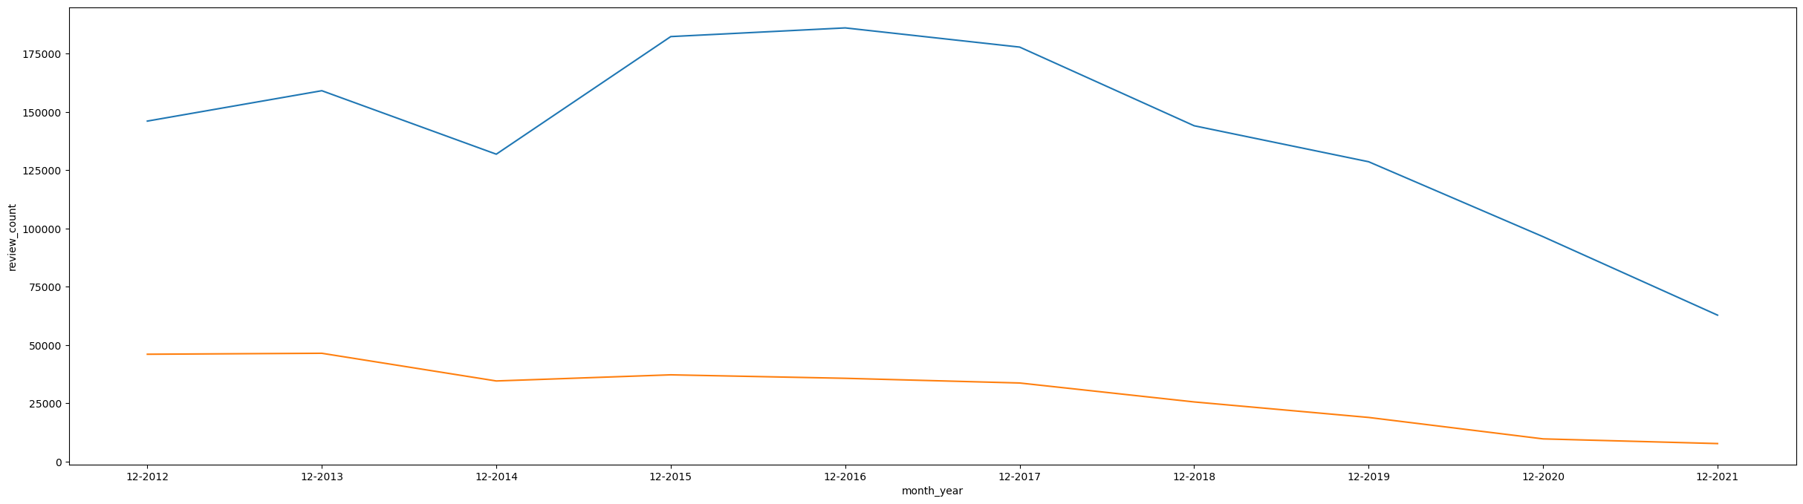
High(>3.5) and low rated(<3.5) vs review count in last 10 years
From the belove data you can observe the high rated business review count are fluctuating year by year.
From 2017 review count is dropped significantly.
Coming to the low rated businesses the review count is dropping contently

Slide 16
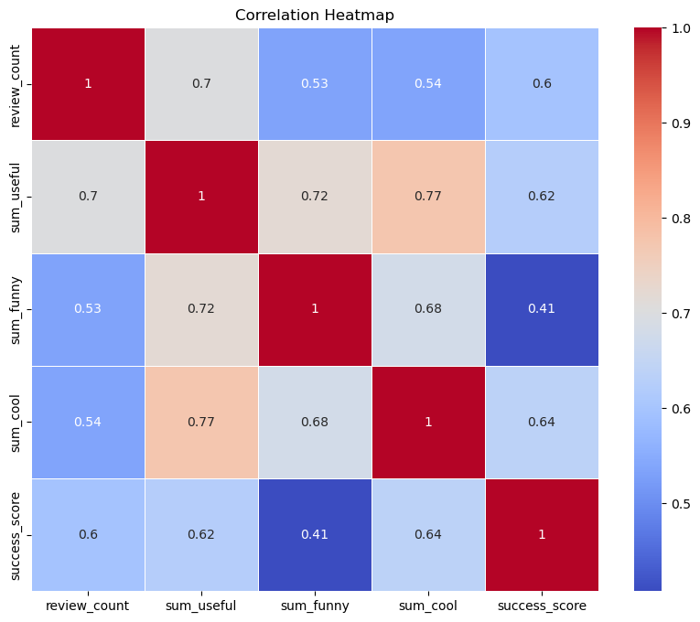
Is there any correlation between review sentiment and success score?
Useful , Funny, Cool are the attributes of the user review.
They represents the feedback provided by user about the usefulness , humor or coolness of a particular review.
Higher counts of the funny, cool and useful represented greater engagement of the customers to the restaurant

Slide 17
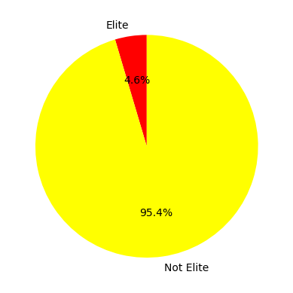
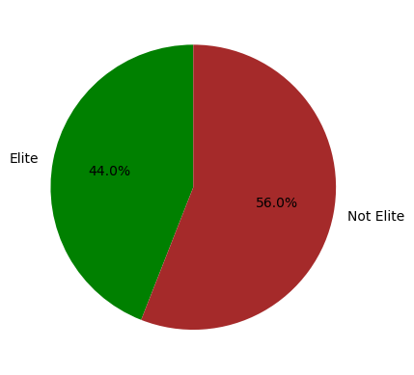
Is there any difference in engagement of elite and non elite users?
Elite users are individually who have been recognized and awarded as the elite status by yelp by their contributions.
Elite users are only 4.6 percentage
Here 4.6 percentage elite users contributed 44 percentage engagement to the restaurant business.
95.4 percentage non elite users contributed 56 percentage engagement to the businesses.

Slide 18
Thank you
Yeruva Jeevan Reddy

